Slide 1


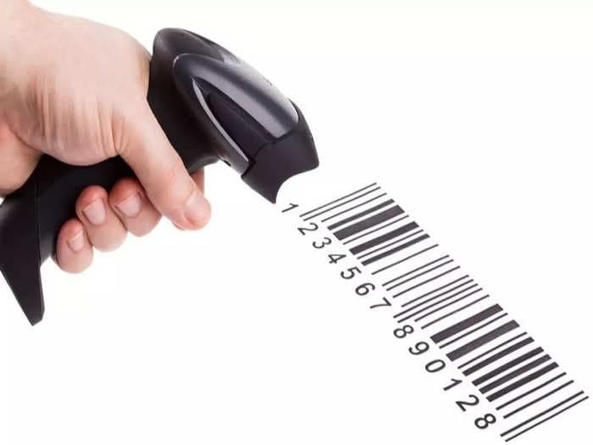
CSA0811 -Python Programming – Slot D
Bar Code Scanner using Python
Guided By, Project By,
T. Vincent Gnanaraj P. Karthik Rao
(Course Faculty) (192224109)
Python Programming AI & DS
SSE, SIMATS SSE, SIMATS

Slide 2

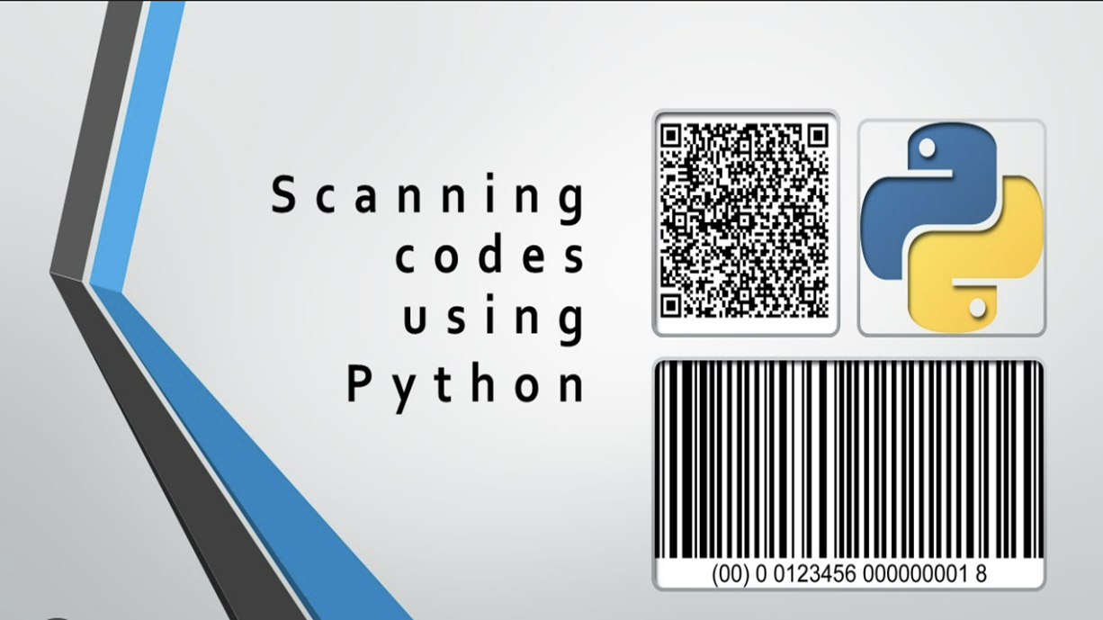
Abstract
Barcode scanning is a vital component in various industries for data collection, inventory management, and retail operations. Leveraging Python's powerful libraries, this presentation delves into the implementation of a barcode scanner using Python. The session explores the fundamental concepts of barcode scanning, introduces key Python libraries for decoding barcodes, and provides practical demonstrations of how Python can be utilized to read and process different types of barcodes. Additionally, the presentation discusses best practices, challenges, and real-world applications of barcode scanning in Python, highlighting its significance in streamlining data retrieval and enhancing operational efficiency.
Keywords: Barcode scanning, Python programming, Data collection, Decoding barcodes, Data processing

Slide 3
Introduction
Barcodes are the ubiquitous symbols representing data in a machine-readable format. It is a predefined format of dark vars and white spaces
A barcode reader (or barcode scanner) is an electronic device for reading printed barcodes.
Like a flatbed scanner, it consists of a light source, a lens and a light sensor translating optical impulses into electrical ones.
Additionally, nearly all barcode readers contain decoder circuitry analyzing the barcode's image data provided by the sensor and sending the barcode's content to the scanner's output port.
Python is a versatile and powerful programming language that offers an array of libraries and tools that simplify the implementation of barcode scanning applications.
Its ease of use, extensive library support, and flexibility make it an ideal choice for developing efficient barcode scanning solutions.

Slide 4
Harware & Software Requirements
HARDWARE :
PROCESSOR : 12th Gen Intel(R) Core(TM) i5-12500H (16 CPUs), ~2.5GHz
STORAGE : 512GB SSD
MEMORY : 16GB RAM
GRAPHIC CARD : Intel(R) Iris(R) Xe Graphics
SOFTWARE :
OS : WINDOWS11
Editor: IDLE
SDK: Python 3.12
PACKAGE :
Requests Library for bar code reading
Pyzbar library is used

Slide 5
Existing System
In the existing system, traditional barcode scanners or separate software tools are used for scanning barcodes and QR codes.
Often, these systems might lack flexibility or customization, requiring specialized hardware and software configurations.
The process might involve manual entry or proprietary software, leading to potential inefficiencies and limited integration with other systems.
The existing system might lack automation, causing delays in data processing and retrieval.
Different devices or systems might have been used for barcode/QR code scanning, leading to inefficiencies in data handling and compatibility issues.

Slide 6
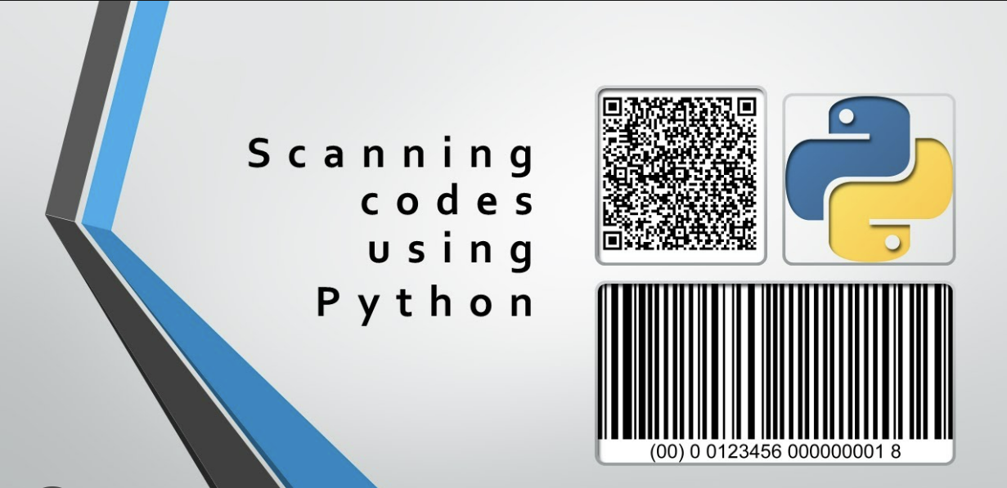
Proposed System
Enhanced Efficiency: Implementing a barcode/QR code scanner using Python streamlines the data entry process, reducing manual efforts and improving efficiency.
Customization and Scalability: Python's flexibility allows for customization and scalability, enabling modifications and additions to meet evolving business needs.
Automated Data Processing: By automating the data retrieval process, the proposed system aims to minimize errors and increase the speed of data processing.
Unified Platform: This system provides a unified platform for code scanning, eliminating the need for multiple devices or systems.
Consolidation of Functions: The proposed system integrates various code scanning functionalities into a single Python program, simplifying the data capture process.

Slide 7
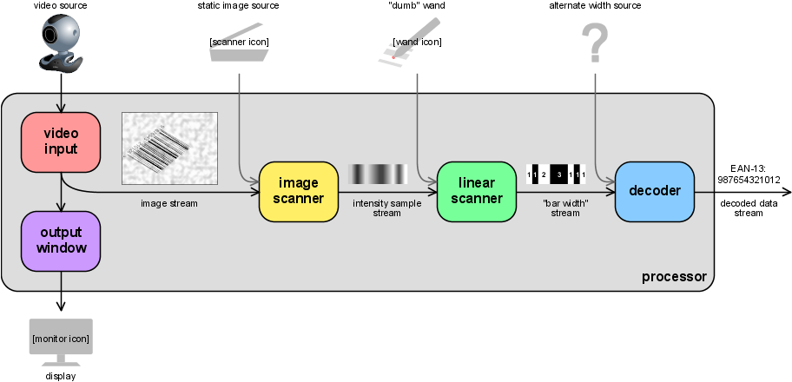
Architecture

Slide 8
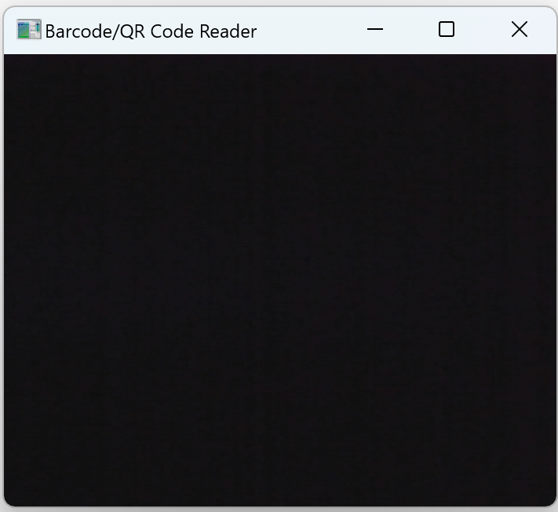
Design

Slide 9
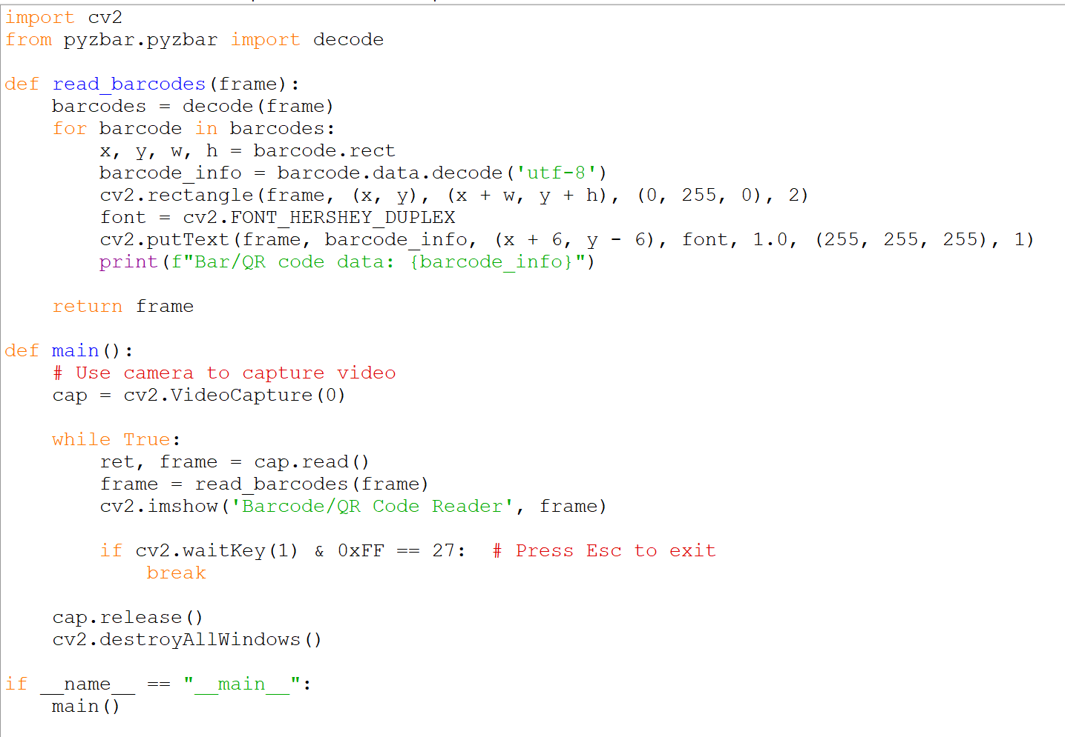
Coding

Slide 10
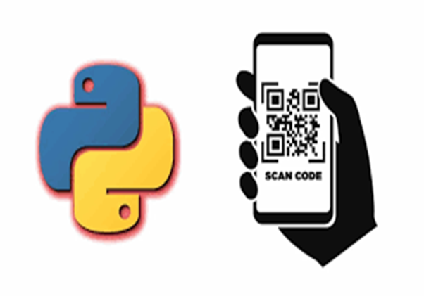
Testing
Types of Testing:
Unit Testing: Ensures individual codes work correctly.
Integration Testing: Verifies the interaction between different codes.
User Testing: Display various QR codes in front of the camera to check if the QR codes are accurately decoded and displayed in the terminal.
Test Cases and Results: Test cases designed to cover various scenarios, from simple to complex web structures.
Results are documented and analyzed for improvements.

Slide 11
Implementation
Camera Input: Utilize OpenCV to capture frames from the camera.
Decoding: Use the pyzbar library to decode information from barcodes and QR codes within the captured frames.
Drawing Boundaries: Draw bounding boxes around detected codes for visual clarity.
Information Extraction: Extract the decoded information and display it on the screen.
Data Storing: Store and save the data in the dataset

Slide 12
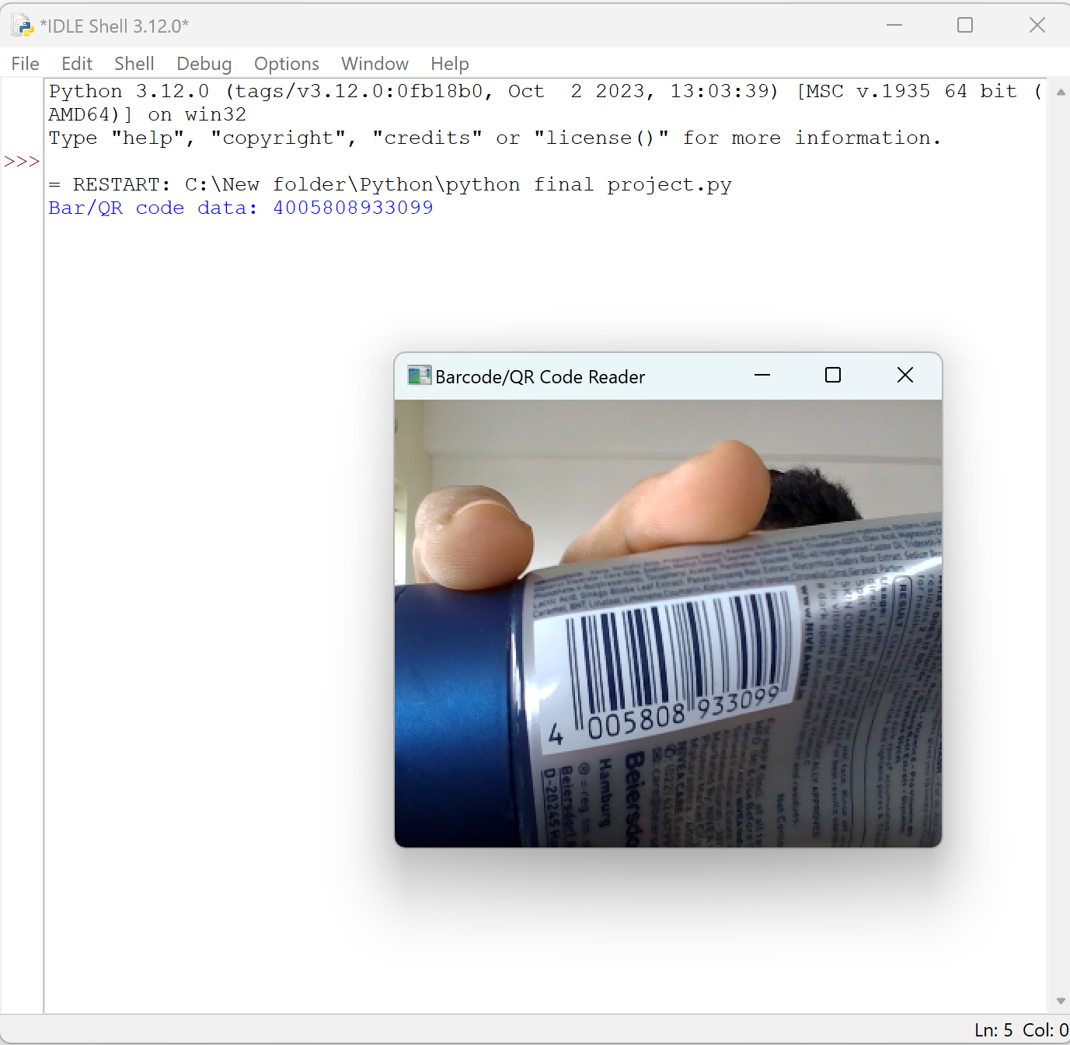
Final Output

Slide 13
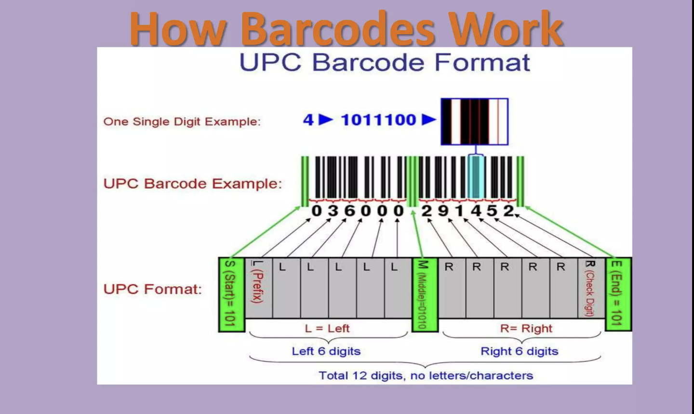
Working
A barcode is a series of dark and light parallel lines of varying thickness. The numbers 0 to 9 are each represented by a unique series of lines. Various barcode methods for representing these digits exist.
Barcode scanners use a light source and a photosensitive receiver to read the information stored in barcodes.
When the scanner is passed over the barcode, the light source illuminates the bars and spaces in the code, and the receiver detects the reflected light.
This pattern of reflected light is then converted into a digital signal that can be decoded by a computer or other device.

Slide 14
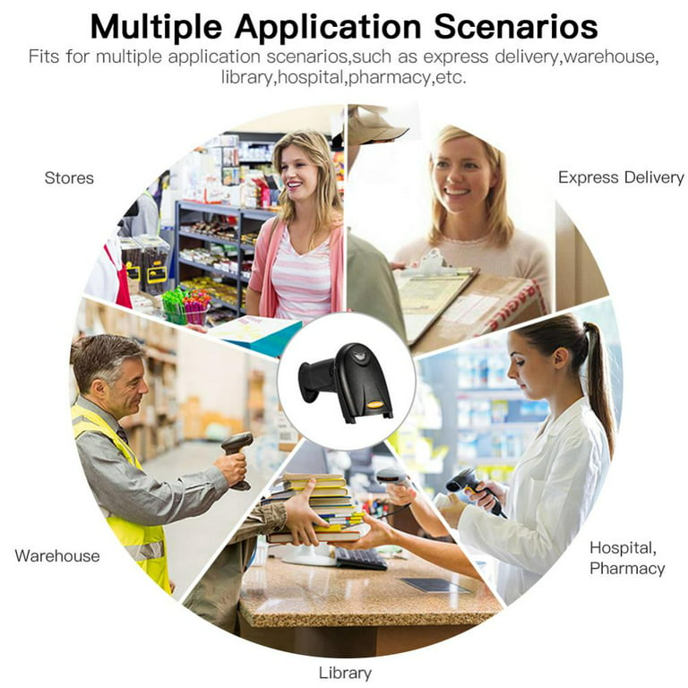
Applications of Bar Code Scanner
Stores: Barcode scanners are extensively used in retail stores to quickly and accurately scan product barcodes during checkout, enabling faster transactions and reducing errors.
Health Care: Barcodes on wristbands or medical records help accurately identify patients, ensuring the right treatment and medication administration.
Warehouse: They facilitate efficient inventory management by tracking stock levels, automating reordering processes, and monitoring product movements within warehouses.
Package Training: Barcodes enable easy tracking and tracing of packages throughout the shipping process, from warehouse to delivery, enhancing logistics efficiency.

Slide 15
Conclusion
Implementing a barcode or QR code scanner using Python presents an efficient solution to streamline data retrieval, enhance operational efficiency, and reduce errors. By leveraging Python's libraries like 'pyzbar', businesses can significantly improve their processes, automate tasks, and ensure accuracy in data handling, thereby optimizing overall performance and facilitating seamless integration within their systems. This program demonstrates the power of Python in enabling quick and reliable barcode and QR code scanning, emphasizing its potential in modernizing data-centric operations across diverse industries.

Slide 16
Future Scope
Integration with live video streams for real-time barcode scanning.
Enhancing the user interface for better interaction and visualization of scanned data.
Implementing error handling and data validation for different barcode types.
Integrating the program with databases or APIs to process and store scanned data.
Adding support for more barcode formats or exploring advanced features for complex use cases.
These enhancements can make the project more versatile, robust, and useful in various industries like retail, inventory management, logistics, and more.

Slide 17
References
J. J. Mira, "Bar and Quick Response Codes Helping Elderly Patients for a Safer Drug Use," in Medicine 2.0 Conference, Toronto, Canada, 2014
“Share your Wi-Fi SSID & Password using a QR Code”. 19 July 2015. Archived from the original on 12 January 2023. Retrieved 6 January 2018
F. Von "Evaluation of 1D barcode scanning on mobile phones," in Internet of Things (IOT), 2010F, "Evaluation of 1D barcode scanning on mobile phones," in Internet of Things (IOT), 2010
J. M. Coughlan, "A mobile phone application enabling visually impaired users to find and read product barcodes," in Computers Helping People with Special Needs, ed Berlin Heidelberg: Springer, 2010, pp. 290-295
Droid 19 August 2011. Archived from the original on 15 September 2012. Retrieved 31 August 2011.

Slide 18
THANK YOU
Name : P. Karthik Rao
Reg No: 192224109

